Slide 1



Rhode Island Tobacco Retailer Compliance Training
License Holder Training Module
Rhode Island
Department of Behavioral Healthcare, Developmental Disabilities & Hospitals (BHDDH)
Notes:
Welcome to the Rhode Island tobacco retailer compliance training. This training is mandatory for all retailers who hold or wish to hold a valid tobacco retailer license with the State of Rhode Island.

Slide 2

Learning Objectives
Identify and describe what a tobacco product is, and which tobacco products are legal for sale
Understand laws that are relevant to the retail sale of tobacco products
Understand what is required to maintain compliance with the law in terms of employee training, record-keeping, and signage
Describe acceptable forms of identification and describe the best practices for age verification
Identify additional resources to help retailers maintain compliance
Notes:
There are several important things that all tobacco retail license holders need to know and understand so that they remain in compliance with State and Federal law. By the end of this training, you will be able to identify and describe what a tobacco product is and which tobacco products are legal for sale in our state. You will understand the laws that apply to tobacco products and what is required of you, the license holder, in order to maintain compliance with the law. You will understand what forms of identification are valid and acceptable and be able to describe how to verify a customers age. You will also know where to go to find additional resources to help you and your retail outlet maintain compliance.

Slide 3
Why is Tobacco Regulated?
Relevant Health Background Information

Slide 4
Overview
According to the Centers for Disease Control and Prevention:
  Tobacco use is the single most preventable cause of disease, disability, and death in the United States. Cigarette smoking causes more than 480,000 deaths in the United States every year, including approximately 41,000 nonsmoking adults and 400 infants who die from secondhand smoke exposure.
AND
  Smoking-related illness in the United States costs over $300 billion each year—about $225 billion for direct medical care for adults and more than $156 billion in lost productivity, including $5.6 billion in lost productivity due to secondhand smoke exposure.
https://www.cdc.gov/policy/polaris/healthtopics/tobacco/index.html#:~:text=Economic%20Burden,due%20to%20secondhand%20smoke%20exposure.
Notes:
Tobacco use is the leading cause of preventable death, disease, and disability in the United States. Many adult smokers who smoke cigarettes on a daily basis report that they first smoked cigarettes by age 18. Persons who begin smoking during adolescence are more likely to experience smoking-related health problems. The younger that youth are when they start using tobacco, the more likely they will be addicted to nicotine, which prolongs tobacco use and can lead to severe health issues. Nearly half a million Americans die prematurely from tobacco use each year.

Slide 5
Tobacco in Rhode Island
1,800 Rhode Islanders die each year from smoking
109,900 Rhode Island adults who smoke
29.8% Deaths from cancer caused by smoking
$744 Million The amount of direct costs to healthcare caused by smoking
$1,137 The amount each Rhode Island household pays in tax for smoking- caused government spending
$1.1 Billion The amount of productivity lost in Rhode Island each year due to smoking
Source: https://www.tobaccofreekids.org/problem/toll-us/rhode_island, Accessed 10/3/2023
Notes:
One thousand eight hundred Rhode Islanders die each year from causes directly related to their own smoking. That is nearly five people a day. Smoking kills more people than alcohol, AIDS, car crashes, illegal drugs, murders and death by suicide combined. And that is not including those that die from other tobacco-related causes such as fires caused by smoking and smokeless tobacco use.

Slide 6
Tobacco in Rhode Island – Children and Youth
1,700 The number of high school students who smoke
17.8% The percentage of high school students who vape
38% Percentage of youth who vape that purchase their products from a gas station or convenient store
1,100 The number of kids (under 18) who try cigarettes for the first time each year
Source: https://www.tobaccofreekids.org/problem/toll-us/rhode_island Accessed 10/3/2023,
RI Young Adult Survey 2022

Slide 7
Laws, Penalties and Definitions

Slide 8
Governing Laws
Federal Drug Administration (FDA)
Under the Tobacco Control Act, FDA has broad authority to regulate the sale and marketing of tobacco products to improve public health, and protect children and adolescents from the harms of tobacco use. Retailers can play an important role by complying with federal regulations on the sale, distribution, and marketing of tobacco products.
State of Rhode Island
The use of tobacco by Rhode Island children is a health and substance abuse problem of the utmost severity.....It is the intent of this legislation to preserve and protect the health of children by (1) stopping the illegal sale of tobacco to children, and (2) by severely punishing those who disregard the laws relating to the illegal sale of tobacco products to children.
Notes:
It is important for you, as a tobacco retail license holder, to understand that there are two sets of laws that your establishment MUST comply with. Those administered through the Federal Drug Administration (FDA) through the Tobacco Control Act, and Rhode Island State law, title 11, chapter 9, section 13. There are many components to each of these laws. This training will focus on Rhode Island laws. There will be links throughout so that you can access the details of Federal law. It is your responsibility to educate yourself on FDA laws.

Slide 9
Rhode Island General Laws § 11-9-13
§ 11-9-13. Sale or delivery of tobacco products, including electronic nicotine-delivery system products to individuals under twenty-one (21)
  No person shall sell, give, or deliver to any individual under twenty-one (21) years of age, any tobacco product in the form of cigarettes, bidi cigarettes, cigars, little cigars, flavored cigars known as “blunts,” unflavored “blunts,” flavored and unflavored blunt wraps, cigarette rolling papers of any size or composition, cigarillos and tiparillos, pipe tobacco, chewing tobacco, snuff, electronic nicotine-delivery system products, or any and all products as defined in § 44-20-1. Any person, firm, or corporation that owns, manages, or operates a place of business in which tobacco products are sold, including sales through tobacco product vending machines, shall post notice of this law conspicuously in the place of business in letters at least three-eighths of an inch (⅜″) high.
Notes:
We’re going to spend a little bit of time going over some of the components of relevant RI State law, most of which sits in title 11, chapter 9, section 13.
Rhode Island law prohibits the sale of tobacco products, including ENDS products to anyone under 21 years of age, and states that notice of this law must be posted everywhere tobacco products are sold.
There are 20 subsections of this law that expand on and provide detail and context to the law written here. On the next slides, we’ll go through some of what you need to know about those subsections, and where to find the language in this law so that you can refer back to it if you have any questions.

Slide 10
Rhode Island General Laws § 11-9-13
Subsections § 11-9-13.1. through § 11-9-13.20. include information on the detailed prohibitions and requirements of legal tobacco product sales. Some components include:
  Vending Machines
  Signage – RI law requires signs regarding, 1. legal age and identification requirements, and, 2. the health effects of tobacco to be displayed prominently for public view, as does Federal law.
  Packaging – all products must be in the manufacturers original packaging, it is against the law to sell loosie cigarettes or any other unpackaged product, any ENDS liquid must be in child-resistant packaging, meeting applicable child-resistant effectiveness standards
  Discounts, coupons, vouchers or free products are prohibited – separate and additional fines apply for any violation
  Operating without a dealer license – subject to $10,000 fine
Notes:
Subsection 1 governs vending machines.
Subsections 7 and 8.1 tell you what signs you must display and where
Subsections 8 and 20 require that any tobacco product sold must be in its original packaging and that ENDS products must be in child-resistant packaging.
Subsection 10 prohibits the distribution of any tobacco product for free or at a discount. There are separate and additional fines for any violation of this statute
Subsection 11 details the requirements for any delivery or online sale of tobacco products
Subsection 15 states that you must maintain a valid dealer license. Operating without one subjects you to a $10,000 fine

Slide 11
Defining a Tobacco Product
Any product containing, made of, or derived from tobacco or nicotine including:
    Cigarettes and bidi cigarettes – including rolling papers
    Cigars or little cigars (cigarillos) including:
      Any roll, made wholly or in part of tobacco regardless of size, shape or if there are any additive ingredients
  Spitting tobacco, which includes:
      Snuff, powdered tobacco, chewing tobacco, dipping tobacco, pouch tobacco, or smokeless tobacco
  Electronic nicotine-delivery system (ENDS) including:
      Electronic cigarette, electronic cigar, electronic cigarillo, electronic little cigars, electronic pipe, or electronic hookah, heat not burn products, e-liquids, e-liquid products, or any related device and any cartridge or other component of such a device
      Parts such as batteries, blanks, cartridges, chargers, closed pod systems, dab pens, disposables, mods, open/refillable systems or devices, pods, skins, kits, tanks, vape juice, or any other part of an ENDS device
Notes:
On this slide, we’ll spend a few minutes defining what a tobacco product is and go over examples. Both Rhode Island and Federal Drug Administration laws govern all tobacco products. These are any products that contain, are made of or derived from tobacco or nicotine. Tobacco products include:
Cigarettes
Cigars or little cigars, sometimes called cigarillos. These include any roll which is made entirely or partially from tobacco. It doesn’t matter how big or small it is, what shape it is or if there are any other ingredients. Even if it is made mostly of other ingredients, if there is any tobacco at all, it is considered a tobacco product.
Spitting tobacco is a category that includes snuff, powdered tobacco, chew, dip, pouches and smokeless tobacco
ENDS are electronic nicotine delivery systems, better known as vapes. ENDS include any electronic product, such as an e-cigarette, e-cigar, e-cigarillo, e-little cigar, e-pipe, e-hookah, heat not burn products, e-liquids, e-liquid products or any related device AND any cartridge or other component of such a device. Examples of device components include batteries, blanks, cartridges, chargers, closed pod systems, dab pens, disposables, mods, open or refillable systems or devices, pods, skins, kits, tanks, and any kind of vape liquid (or juice), regardless of its container.
In addition to RI law, there are more restrictive Federal policies that govern ENDS devices and products. We will talk more about where to find those later and what you need to know to be in compliance with FDA law

Slide 12
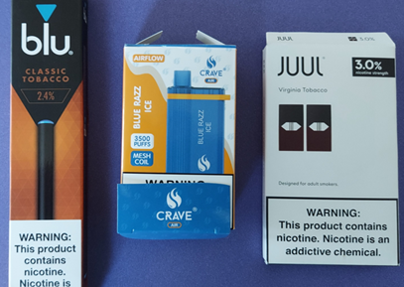

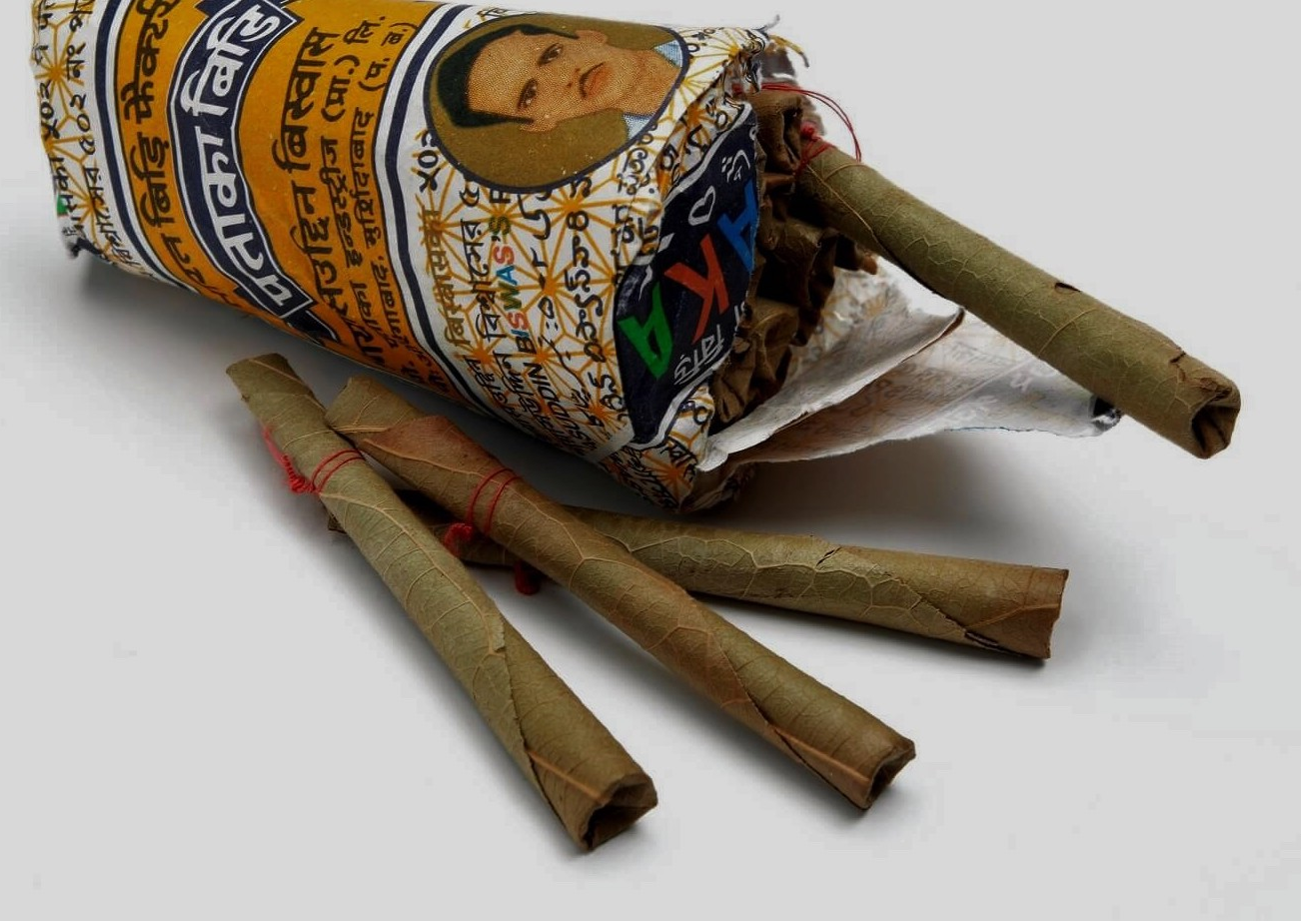
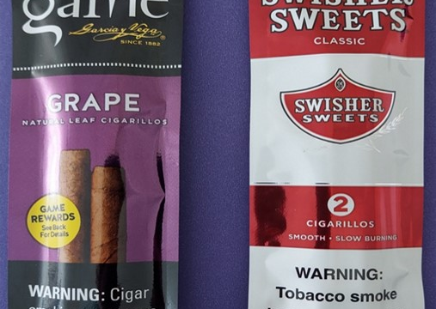
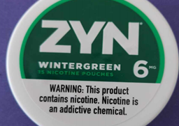
Common non-cigarette tobacco products

Slide 13
Fines and Penalties
Rhode Island law requires compliance checks for retailers. Violators are issued citations and are required to pay applicable fines and penalties and/or appear in court. Multiple citations can result in suspension of retail license.
More information about Rhode Island State fines and penalties can be found in subsection § 11-9-13.12., § 11-9-13.13., and § 11-9-13.15. of general law.
Notes:
Both State and Federal law require compliance checks for retailers. A compliance check is when someone who is underage attempts to purchase a tobacco product from a retail establishment as a way of ensuring retailers and their staff are following the statutes we’ve just talked about. Any retail establishment found to be in violation of law are issued citations and required to pay fines and penalties, and could be mandated to appear in court. As the license holder, you are always responsible for the actions associated with your establishment, even if you are not the person who made the violation.
For more information about Rhode Island fines and penalties, click the links on this page.

Slide 14
Federal Laws and FDA
Flavored tobacco products are banned according to Federal Law.
To protect the public and create a healthier future for all Americans, the Family Smoking Prevention and Tobacco Control Act (Tobacco Control Act), signed into law on June 22, 2009, gives FDA authority to regulate the manufacture, distribution, and marketing of tobacco products.
FDA also requires retail surveys for compliance. Officers of the FDA, working with local Police Departments conduct checks for underage sales and compliance with federal restrictions on product placement, among other things. More about the FDA rules and regulations on tobacco products can be found here.
Notes:
The federal government also has laws about tobacco, under the FDAs Tobacco Control Act.
You are responsible for educating yourself about federal laws and current product restrictions. FDA officers also conduct compliance checks pertaining to underage sales and restricted products. Please click the links on this page to learn more about Federal law and guidelines for compliance at the Federal level.

Slide 15
FDA Links
Selling Tobacco Products in Retail Stores [fda.gov] – A comprehensive summary of federal rules
Tobacco Retailer Training Programs [fda.gov] – Guidance document to assist retailers with implementing training programs for employees to learn about and comply with the Federal laws, including regulations
“Tobacco 21” Resource Hub [fda.gov] – A collection of information, commonly asked questions and other resources about the recent T21 legislation
For more information and training tips visit https://www.fda.gov and search for “retailer training and enforcement”

Slide 16
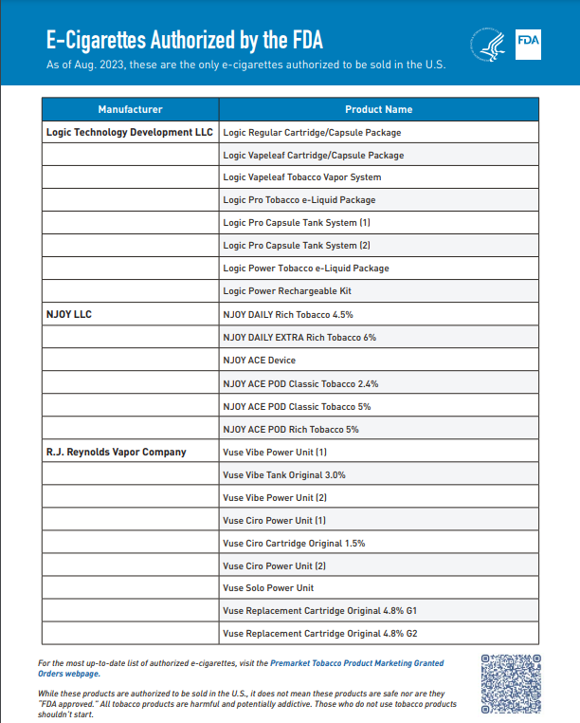
If an E-Cigarette is not on this list, it is illegal under Federal law to sell it to anyone.
Notes:
The FDA is always updating its list of products that are legal for sale. Please scan the QR code here and visit the FDA tobacco compliance website for the most up to date information. It is your responsibility to stay up to date with FDA rules and regulations.
The Food and Drug Administration began cracking down on vaping back in 2020 by requiring products be approved for sale. To date, only 23 e-cigarette products are legal to sell, and they are all tobacco-flavored. Jul 12, 2023

Slide 17
Training, Record-Keeping and Signage
Notes:
The next section of this training will go through some additional requirements. We will talk about what training is required for both you, as the license holder, and your staff. We will detail what records and documentation you need to keep and for how long, and finally what signs you are required to have in your retail establishment and where you have to place them.

Slide 18
Training Program for Employees
All staff members of any retail establishment that sells tobacco products must complete training.
Evidence of successful training must be kept on file for each employee for their entire period of employment and for one year after
Notes:
Clerks of your retail establishment are all required to complete training in order to sell tobacco products. BHDDH provides a training that fulfills this requirement. Once your staff member completes the BHDDH training, you will receive a certification form that you must keep on file for the length of employment for each staff member, and for one full year after termination of employment.
It is in your best interest to support ongoing training activities for your staff, as you as the license holder will bear the legal consequences of any violations on their part.

Slide 19
Required Record-keeping
Retailers must review Rhode Island law with all employees
All employees must sign an acknowledgement form that the employer reviewed applicable Rhode Island laws with them
Each written record must be kept for the time staff are employed and for one year after termination
Notes:
You are required to review Rhode Island law with your employees.
You and your employees must sign a form that acknowledges you reviewed the law with your employee and that they understand what the law requires of them. This written record has to be maintained for the whole time staff members are employed by you and for a year after they aren’t working for you anymore.

Slide 20
Establish Policies and Procedures
Retailers should have a written policy against the sale of tobacco products to minors and written procedures that include the following:
  Protocols for refusing a sale to a minor
  Protocols for dealing with difficult customers – when to call a manager, what to do when a manager is not present
  System for monitoring employee compliance
  Written consequences for underage sales
Share these policies, explain them to your staff and keep them visible
Consider supportive activities such as role playing denying an underage sale
Consider reinforcement strategies such as reviewing requirements and policies at staff meetings, and annual re-training
Notes:
In addition to the required record-keeping, all retailers should have a written policy against the sale of tobacco products to minors. Such policy needs to be visible and available to all staff.
Retail establishments should have written procedures that detail how to follow store policy against underage sales, and support staff to comply with the law and store policy. These procedures should include how to refuse a sale to a minor, or to a person that doesn’t present a valid ID. It is important that your staff are equipped with strategies for how to ask for ID, how to tell a customer they are not able to sell to them if they don’t have a valid ID, and how to deal with a customer that becomes unhappy or difficult when the clerk is doing their job. You should have procedures in place for when and how staff can ask for help with difficult customers, such as when to call a manager, and what to do if a manager is not available.
Procedures should include a system for monitoring how well staff are complying with policy. How will you be able to tell whether or not your staff are checking IDs every time they make a sale?
And finally, your policies should include consequences for staff who make an unlawful sale.
These policies need to be written down. You should share them with your staff, explain them and make sure staff understand what is expected of them. Keep them visible so that staff can refer to them when they need to.
You want your staff to be well equipped to follow the laws in place, as they are acting as agents of the license holder, and you will be held accountable for any noncompliance on their part. Consider offering supportive activities, such as role-playing what to do when someone doesn’t present an ID or how to refuse a sale to someone who is underage. You can also use staff meeting time to review your policies. The more you do so, the more likely you are to embed these policies into a culture of compliance.

Slide 21
Required Signage
The law requires two signs be displayed prominently for public view, wherever tobacco products, including electronic nicotine-delivery system products, are sold at each cash register, each tobacco product vending machine, including each electronic nicotine-delivery system product vending machine, or any other place from which tobacco products, including electronic nicotine-delivery system products, are sold.
Required signs are available for download in both English and Spanish from our website, https://bhddh.ri.gov/tobacco
Notes:
Rhode Island law requires retail license holders to display two different signs at the point of sale in your establishment. Signs have to be prominently displayed so that they are visible at the place where the sale is happening. This is usually the cash register, or a vending machine, if you have one. It is wherever the money exchange is taking place.
The law is very specific and requires each sign have exact language in exact font size and color. You can click the links here to access each sign so that you can print them.

Slide 22
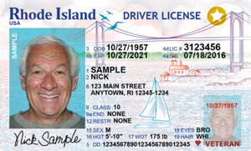
Acceptable Forms of ID
Rhode Island State law requires that a valid form of identification be shown for every tobacco product purchase made in the state. Retailers are required to ask for and verify the identification for each person making a purchase of tobacco products every time they do so.
Notes:
You now know that Rhode Island law requires you and your staff to check the identification for each customer that wants to purchase any tobacco product, and ensure that the identification you are looking at is valid. So, what makes an ID valid? A valid ID has been issued by the state or federal government, has a picture on it, and is current – meaning it is not past its expiration date.

Slide 23
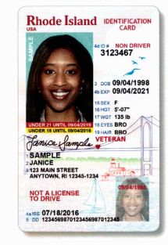
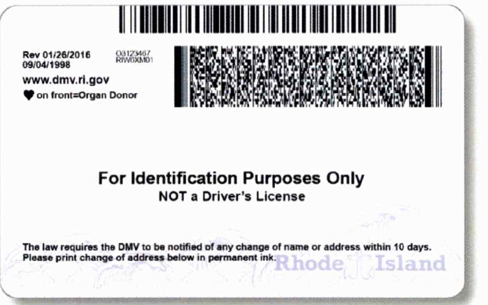
Examples of Acceptable Forms of Identification
Driver's license or other state photo identification card issued by the Department of Motor Vehicles (or equivalent)
Federally recognized tribal-issued photo ID
Foreign government-issued passport
U.S. Citizenship and Immigration Services Employment Authorization Card (I-766)
Notes:
Valid forms of identification include State-issued driver’s license or other state issued form of ID from the DMV, a federally issued passport, or foreign government issued passport, a federally recognized tribal issued photo ID, or a Card I-766, which is an employment Authorization card issued by US Immigration Services.
Many states issue IDs for people under 21 that look obviously different. Ours here in RI are turned to be vertical, as are those from Connecticut and Massachusetts. This takes the guesswork out of calculating a purchasers age.

Slide 24

Age Verification Techniques
Stand-Alone Age Calculator Systems
Point-of-Sale Systems that Prompt
Employee to Check ID
Point-of-Sale Systems that Prompt
Employee to Enter Date of Birth
Point-of-Sale Systems Requiring
that IDs Be Scanned
Notes:
There are several age verification systems available to you.
Stand alone age calculator systems are a device or a calendar that cashiers can use to check against the date of birth on an ID. These systems tell the cashier what date the customer must be born BEFORE in order to be of legal purchasing age.
There three types of point of sale systems that verify age. One type will prompt the cashier to check an ID. This is just a reminder that pops up.
Another asks the cashier to enter the date of birth. This is a more effective system, as the cashier has to enter something to make the sale, and often they are less likely to fabricate an age than they are to bypass the prompt to check ID.
Finally, there are point of sale systems that require an ID to be scanned for purchase. These are the most effective way to ensure compliance with each tobacco product sale. They remove the possibility of human error in sales, whether that error is resulting from ignorance, customer pressure, or purposeful noncompliance.

Slide 25
Resources
Regional Prevention Director Contact
If your store is in: | Your regional prevention director is:
Burrillville, Central Falls, Cumberland, Lincoln, North Smithfield, Pawtucket, Woonsocket | Lisa Carcifero lcarcifero@woonsocketpreventioncoalition.org
Coventry, East Greenwich, West Greenwich, Exeter, Warwick, West Warwick | Kathy Sullivan ksullivan@risas.org
Barrington, Bristol, Warren, East Providence | Denise Alves dalves@barrington.ri.gov Kristen Westmoreland kwestmoreland@barrington.ri.gov
Jamestown, Little Compton, Middletown, Newport, Portsmouth, Tiverton | Rebecca Elwell elwell@riprevention.org
Providence | Obed Papp opapp@providenceri.gov
Charlestown, Hopkinton, Narragansett, New Shoreham, North Kingstown, Richmond, South Kingstown, Westerly | Heidi Driscoll hdriscoll@risas.org
Cranston, Foster, Gloster, Johnston, North Providence, Scituate, Smithfield | Patty Sweet psweet@tricountyri.org
Notes:
Rhode Island has seven prevention coalitions. The role of prevention is to promote health and to prevent substance use and misuse among youth, including tobacco products. Your regional prevention director can be a resource and partner to you in compliance with the law and as a member of your community.

Slide 26
Questions
Please email any questions you may have to:
BHDDH.TobaccoTraining@bhddh.ri.gov
PLEASE CLICK THIS LINK TO COMPLETE A BRIEF QUIZ
Notes:
Thank you for completing the State of Rhode Island’s retail tobacco license holder training module. You will now be directed to a quiz in order to test your knowledge about what we’ve just learned. Please email any questions you may have to BHDDH.tobaccotraining@bhddh.ri.gov

Slide 27

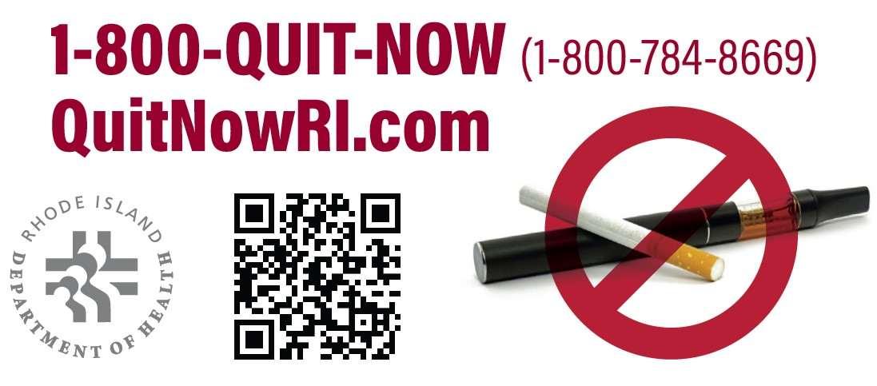
Free Treatment Resources for Tobacco/Nicotine Use
Rhode Island offers free, effective, and confidential help for adults and youth.
Rhode Island Nicotine Helpline
Adults 18+
  Call: 1-800-QUIT-NOW / 1-800-8-DEJALO
  Visit: QuitNowRI.com
My Life My Quit
Youth 13-17 years old
  Text: “Start” to 36072
  Call: 855-891-9989
  Visit: mylifemyquit.com
Notes:
Quitting tobacco is the best thing you can do for your health. Combining counseling support with medication support like the patch or lozenge can double your chances of a successful quit.
If you or someone you know is looking to quit tobacco/nicotine, please visit the Rhode Island Nicotine Helpline for free counseling and nicotine replacement therapy. Services are available to all Rhode Islanders regardless of income, insurance, or citizenship. Services are available in over 100 languages
Additionally, customized, free, and confidential help is available for youth 13-17 through My Life My Quit.

Slide 28
CONTACT INFORMATION
BHDDH.TobaccoTraining@bhddh.ri.gov

