Slide 1



Rhode Island Tobacco Retailer Compliance Training
Retail Employee Training Module
Rhode Island
Department of Behavioral Healthcare, Developmental Disabilities & Hospitals (BHDDH)
Notes:
Welcome to the State of Rhode Island’s training for tobacco sales compliance. This training has to be completed by everyone who will be selling tobacco products as a part of their job.

Slide 2
Learning Objectives
By the end of this training, you will:
Understand what tobacco products are
Understand who can legally purchase tobacco products
Understand how to calculate and verify someone’s age
Learn how to deal with someone trying to buy tobacco products who is underage or doesn’t have an ID
Notes:
Today we will be covering lots of information about tobacco products. By the end of this training, you will be confident that you know what a tobacco product is. You will know who can and who cannot purchase tobacco products. You will know how to calculate someone’s age to know whether they are allowed to purchase tobacco products or not. You will know what to look out for when someone tries to buy tobacco product illegally. Finally, we will give you tips and tricks to deal with someone who is trying to make a purchase but doesn’t have an ID, or if their ID is not valid

Slide 3
Introduction
According to the Centers for Disease Control and Prevention:
    Tobacco use is the single most preventable cause of disease, disability, and death in the United States. Cigarette smoking causes more than 480,000 deaths in the United States every year, including approximately 41,000 nonsmoking adults and 400 infants who die from secondhand smoke exposure.
  AND
    Smoking-related illness in the United States costs over $300 billion each year—about $225 billion for direct medical care for adults and more than $156 billion in lost productivity, including $5.6 billion in lost productivity due to secondhand smoke exposure.

Slide 4
Tobacco in Rhode Island
1,800 Rhode Islanders die each year from smoking
109,900 Rhode Island adults who smoke
29.8% Deaths from cancer caused by smoking
$744 Million The amount of direct costs to healthcare caused by smoking
$1,137 The amount each Rhode Island household pays in tax for smoking-caused government spending
$1.1 Billion The amount of productivity lost in Rhode Island each year due to smoking
Source: https://www.tobaccofreekids.org/problem/toll-us/rhode_island Accessed 10/3/2023
Notes:
One thousand eight hundred Rhode Islanders die each year from causes directly related to their own smoking. That is nearly five people a day. Smoking kills more people than alcohol, AIDS, car crashes, illegal drugs, murders and death by suicide combined. And that is not including those that die from other tobacco-related causes such as fires caused by smoking and smokeless tobacco use.

Slide 5
Tobacco in Rhode Island – Children and Youth
1,700 The number of high school students who smoke
17.8% The percentage of high school students who vape
38% Percentage of youth who vape that purchase their products from a gas station or convenient store
1,100 The number of kids (under 18) who try cigarettes for the first time each year
Source: https://www.tobaccofreekids.org/problem/toll-us/rhode_island, Accessed 10/3/2023,
RI Young Adult Survey 2022
Notes:
You play a very important role in helping prevent kids from becoming addicted to nicotine or other tobacco products. With your help, we can reduce underage tobacco use and save the lives of youth and young adults who would otherwise become addicted to this substance

Slide 6
What is a Tobacco Product?
RI State Law defines tobacco products as:
Any product containing, made of, or derived from tobacco or nicotine including:
  Cigarettes
  Cigars or little cigars (cigarillos) including:
    Any roll, made wholly or in part of tobacco regardless of size, shape or if there are any additive ingredients
  Bidi cigarettes
  Spitting tobacco, which includes:
    Snuff, powdered tobacco, chewing tobacco, dipping tobacco, pouch tobacco, or smokeless tobacco
  Electronic nicotine-delivery system (ENDS) including:
    Electronic cigarette, electronic cigar, electronic cigarillo, electronic little cigars, electronic pipe, or electronic hookah, heat not burn products, e-liquids, w-liquid products, or any related device and any cartridge or other component of such a device
    Parts such as batteries, blanks, cartridges, chargers, closed pod systems, dab pens, disposables, mods, open/refillable systems or devices, pods, skins, kits, tanks, vape juice, or any other part of an ENDS device
Notes:
On this slide, we’ll spend a few minutes defining what a tobacco product is, and go over examples. A tobacco product is any products that contains, is made of or derived from tobacco or nicotine. These products include:
Cigarettes
Cigars or little cigars, sometimes called cigarillos. These include any roll which is made entirely or partially from tobacco. It doesn’t matter how big or small it is, what shape it is or if there are any other ingredients. Even if it is made mostly of other ingredients, if there is any tobacco at all, it is considered a tobacco product.
Spitting tobacco is a category that includes snuff, powdered tobacco, chew, dip, pouches and smokeless tobacco
ENDS are electronic nicotine delivery systems, better known as vapes. Any electronic product, such as an e-cigarette, e-cigar, e-cigarillo, e-little cigar, e-pipe, e-hookah, heat not burn products, e-liquids, e-liquid products or any related device AND any cartridge or other component of such a device. Examples of device components include batteries, blanks, cartridges, chargers, closed pod systems, dab pens, disposables, mods, open or refillable systems or devices, pods, skins, kits, tanks, and any kind of vape juice, regardless of its container.

Slide 7
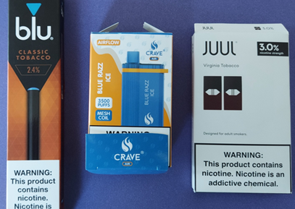
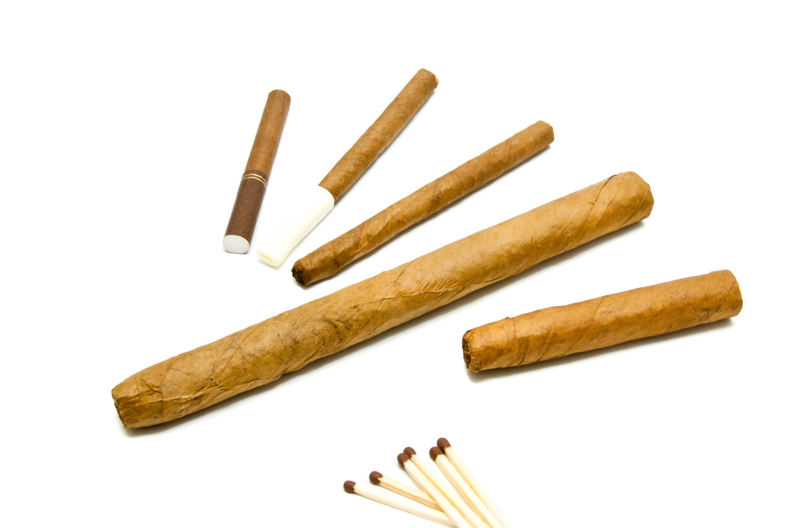
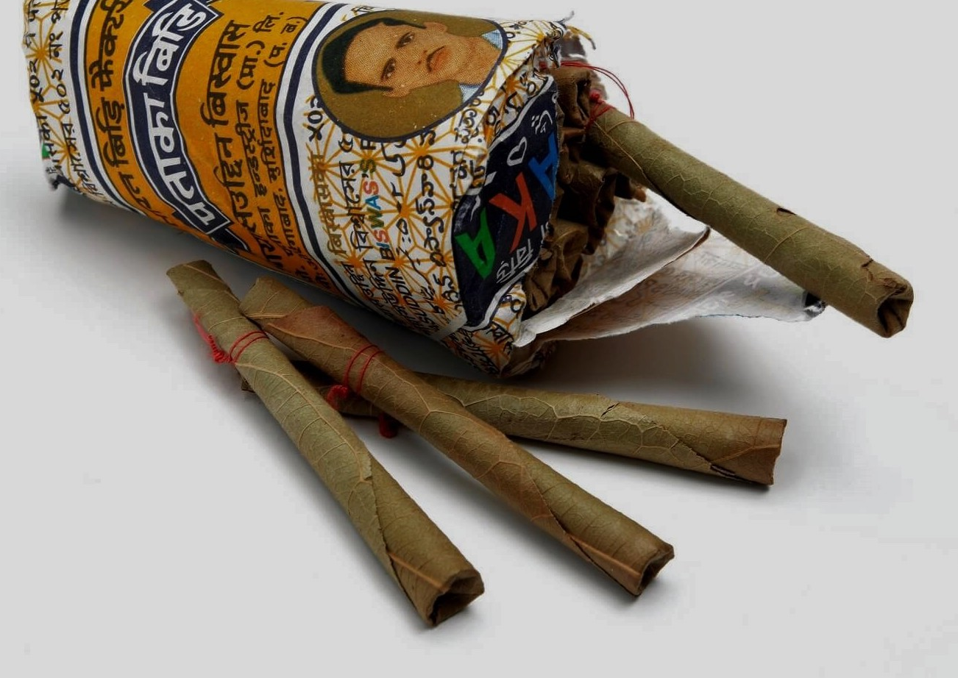
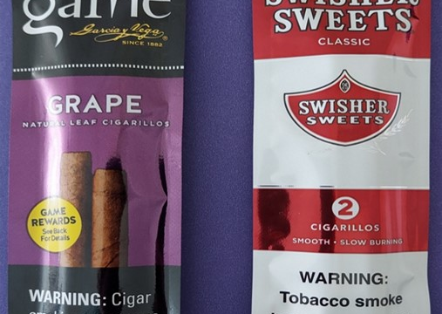
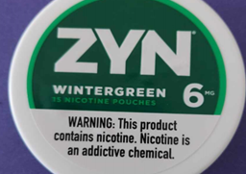
Common non-cigarette tobacco products

Slide 8
Who can purchase tobacco products?
Individuals must be 21 years old to purchase any tobacco product – even just a device, such as a vape, vape battery or rolling papers
You must ask for valid photo identification from anyone who asks to purchase tobacco products. You cannot make the sale if they don’t provide ID.
Notes:
Anyone who wants to purchase a tobacco product has to be 21 years old to do so. This includes both products that contain tobacco and devices such as vape batteries or rolling papers. It is against Rhode Island and federal law to sell any tobacco product to anyone who is under 21.

Slide 9
Age Verification
You must ask for valid photo identification from anyone who asks to purchase tobacco products. You cannot make the sale if they don’t provide ID.
  Acceptable forms of ID (include picture samples)
    Drivers License
    State issued ID
    Passport (US or foreign government issued)
    Military ID
    Permanent Resident/Green Card – US Citizenship and Immigration Services Employment Authorization Card (I-766)
Look at the date of birth (DOB) on the ID. The person must be at least 21 years old today.
Make sure the ID is not expired
Make sure the photo is of the person attempting to make the purchase
Notes:
It is your responsibility to verify the age of everyone who tries to purchase a tobacco product. You have to ask for an ID and You have to make sure it is valid. If someone doesn’t give you an ID, you can’t make the sale.
Valid forms of identification include a State-issued driver’s license or other state issued form of ID from the DMV, a federally issued passport, or foreign government issued passport, a federally recognized tribal issued photo ID, or a Card I-766, which is an employment Authorization card issued by US Immigration Services.
Many states issue IDs for people under 21 that look obviously different. Ours here in RI are turned to be vertical, as are those from Connecticut and Massachusetts. This takes the guesswork out of calculating a purchasers age.
Examples of IDs that are NOT valid are student IDs or IDs that are given by an employer to workers.
When you are given an ID, look at it. Check the date of birth. The date of birth has to at least 21 years ago as of the day you are looking at it. Look at the picture to make sure that is the person in front of you. Make sure that the ID is not expired. It will have an expiration date on it – check that date to be sure it hasn’t passed.

Slide 10
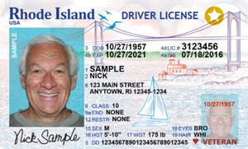
Acceptable Forms of ID
Rhode Island State law requires that a valid form of identification be shown for every tobacco product purchase made in the state. Retailers are required to ask for and verify the identification for each person making a purchase of tobacco products every time they do so.
Notes:
You now know that Rhode Island law requires you and your staff to check the identification for each customer that wants to purchase any tobacco product, and ensure that the identification you are looking at is valid. So, what makes an ID valid? A valid ID has been issued by the state or federal government, has a picture on it, and is current – meaning it is not past its expiration date.

Slide 11
Spotting a Fake ID
How to spot a fake ID or ID that has been tampered with
  Look for imperfections like peeling lamination, bumpy or raised surface, or smudged ink
  Look for glue lines or pinholes under a bright light
  Check that the watermarks and state seal is present
  Check that the numbers match – the ID number and date of birth are printed on the front and back
  Make sure the person attempting to make the tobacco product purchase is the person in the ID picture
  Check for errors
      Spelling errors – Example: Rode Island
      Word usage errors:
        Weight: Brown
        Height: 162
        Eye color: 5’05”
Notes:
Sometimes, people who are not 21 will try to use a fake ID to purchase tobacco products. Here are a few ways you can check to be sure an ID is not a fake.
Look for any imperfections on the ID. These could include peeling of the plastic covering, a bumpy or raised surface, or ink that looks smudged or streaked.
Look at the ID under bright light so that you will notice any pin holes or glue lines. Check that the state seal is present and that the watermark is there in the right place
Check to be sure that the numbers match. An ID will have the same identification number and date of birth printed on both the front and the back
Look at the person in front of you. Make sure that the picture in the ID and the person in front of you look the same
Check the ID for spelling or other mistakes. There are a few listed on this page as examples

Slide 12
Common Mistakes
Common mistakes are when someone is:
  Asking for ID and then not checking the age or miscalculating the age
  Not looking to verify the ID picture is the person attempting to purchase the tobacco product
  Accepting ID that is not a valid government-issued photo ID
  Asking for a customer’s date of birth instead of checking the ID
  The clerk mistaking an individual younger than 21 for an adult customer who is at least 21 and a “regular”
  Inputting random date of birth or clerk’s own date of birth into the computer
  Overriding the computerized system for someone who looks over 21 but doesn’t show a valid ID
Notes:
Here are some common mistakes you should avoid.

Slide 13
Age Verification
Need to verify the age of a customer?
During Calendar Year:
2023 2024 2025
You may sell tobacco to anyone
born after today’s date in:
2002 2003 2004
Notes:
Here is a quick way to calculate that the person whose ID you’re looking at is at least 21
Take a look at the date of birth on the ID. Now, add 20 to the year of birth. Now, add one more. Is that date before today? If so, they are 21. If not, don’t make the sale.

Slide 14
How to Say NO
SAMPLE ILLEGAL SALE SITUATIONS
Underage customer with an ID
When a customer’s I.D. shows that he or she is not old enough, remind them that they have to be 21 to legally purchase tobacco products, electronic cigarette products, and nicotine products.
What to say:
“I’m sorry, it’s against the law for me to sell tobacco products, electronic cigarette products, or nicotine products to anyone under 21.”
Underage customer purchasing for an adult
If parents or other adults send an individual younger than 21 to purchase tobacco products, electronic cigarette products, or nicotine products for them, explain that someone who is at least 21 years old must come in to make the purchase.
What to say:
“I’m sorry, it’s against the law for me to sell tobacco products, electronic cigarette products, and nicotine products to anyone younger than 21.”
Customer without an ID
If a customer does not have I.D., don’t accuse him or her of being younger than 21.
What to say:
“I have to see your valid I.D. before I can sell this to you.”
Notes:
Here are some tips to help you say no when someone who isn’t 21 tries to make a purchase
Let’s imagine you have a customer who shows you their ID when you ask for it. You look at it, and it turns out they’re not 21. You can remind them that they have to be 21 to make the purchase. You can say something like, “I’m sorry, but it’s against the law for me to sell this to you. You have to be 21 to purchase this product legally.”
What happens if an underage customer tells you they’re trying to make the purchase for an adult, not for themselves? If a parent or other adult sends someone under 21 to the store to buy a tobacco product, explain that someone who is at least 21 has to come in to make the purchase. You could say, “I’m sorry, but it’s against the law for me to sell this to you – even if it isn’t for you to use.”
What if a customer doesn’t have an ID? You don’t need to accuse them of being underage – you can simply say, “I have to see your ID before I can sell this to you. It’s the law and I could lose my job if I don’t.”

Slide 15
How to Say NO
SAMPLE ILLEGAL SALE SITUATIONS
Customer without I.D.
If a customer clearly looks at least 21 State law still requires that you must check I.D. prior to sale.
What to say:
“I’m sorry, state law requires that I check the I.D. of all customers attempting to purchase tobacco products. If I don’t, I could lose my job.”
Adult buying for someone underage
If you have reason to believe a customer older than 21 is attempting to purchase tobacco products, electronic cigarette products, and nicotine products for an individual younger than 21, you must refuse the sale. (Customer could be an underage individual's parent, sibling, friend, or a stranger.)
What to say:
“I’m sorry, it looks like you may be purchasing this for someone under 21, so I can’t sell you this product. It is illegal to sell tobacco products, electronic cigarette products, or nicotine products to anyone younger than 21.”
Friend of clerk who is underage attempts to purchase
Don’t be tempted to sell to your underage friends.
What to say:
“It’s nothing personal; it’s just the law. If I sell tobacco products, electronic cigarette products, or nicotine products to you, I could lose my job.”
Notes:
What about if your customer clearly looks over 21, but they don’t have their ID? State law still requires you to refuse the sale. You can tell them that “State law requires that I check the ID of all customers attempting to purchase tobacco products. If I don’t verify your ID, I could lose my job.”
Sometimes, someone who is over 21 will try to buy tobacco products for someone who is underage. If you have any reason to believe a customer over 21 is purchasing for someone who is under 21, you can’t make the sale. Even if it is someone’s parent. You can say something like, “I’m sorry, it looks like you might be purchasing this for someone who isn’t 21, so I can’t sell you this product.”
What if you have a friend that is under 21 who is trying to make a tobacco product purchase? Don’t be tempted to sell to your friends. You can say, “it’s nothing personal, it’s just the law. I could lose my job if I sell this to you.”

Slide 16
How to Say NO
  Dealing with difficult customers
    Explain that it is against the law to sell tobacco products to anyone under 21, that you are required by law to verify ID, and that you could be fired if you don’t.
    Be polite but firm
    Stay calm and remember that you are not obligated to sell any tobacco product
    Focus your attention to the next customer in line
    If the customer gets angry, ask for help from a manager or, if you have them, a security officer
    Offer to get a police officer’s assistance
Notes:
Sometimes, you will have to deal with difficult customers
You can explain what the law says – that it is against the law for you to sell tobacco products to anyone under 21, that you are required to verify ID and that you could be fired if you don’t.
Be polite, but firm
Try to stay calm, and remember – you are not required to sell any tobacco product to anyone. If you refuse a sale because you think you’re doing the right thing – the law is on your side
If you’ve already said no, and the person in front of you is not letting it go, try to focus your attention on the next customer in line
If a customer gets angry, ask for help from a manager – or, if you have them, from a security officer
You could offer to get assistance from the police if you have a customer that is angry or starts to yell

Slide 17
Testing Your Knowledge
PLEASE FOLLOW THIS LINK TO COMPLETE A BRIEF QUIZ
Notes:
You will now be directed to a quiz.
After you complete it, a certificate will be sent to your email address that you provide. Please keep this certificate for your records. A copy of that certificate will also be sent to your employer.

Slide 18
Thank You

